Slide 1
Top Tips for Language Development.

Slide 2
Agenda
A
Talking to your child, Non-Verbal communication
Talking to your child, Verbal cues
Barriers to Language Development
Importance of Songs, Rhyme time
Promoting language through stories.
Games

Slide 3
Non-Verbal Cues
Using body language we can help model good listening skills and help our children with their own attention and listening skills.
Some good signs of whole body listening/ active listening would be:
eye contact
facing the person you are speaking to
nodding your head or giving some reignition of understanding
Getting down to their level
waiting for the speaker to finish before commenting
ignoring distractions

Slide 4
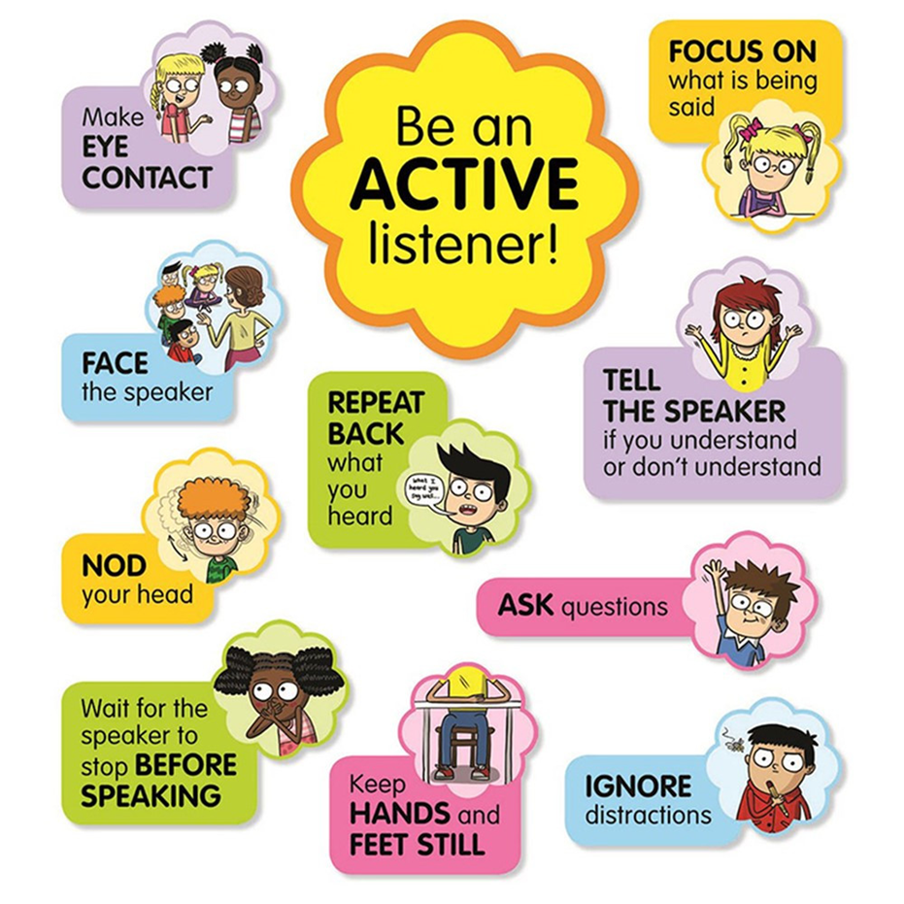
Children who are non-verbal may rely on non-verbal cues to communicate these can come in the form of:
pointing
taking your hand and leading you to where they want to go
showing you items, pictures
When this occurs start by using one/ two word replies, phrases i.e. if your child points to a biscuit, “biscuit” or “ I want a biscuit” this can help model the language they need to ask in future.

Slide 5
Verbal Cues
When talking to your child some ways to grab their attention and help their language can be done through:
Commenting on what they are doing, labelling items, e.g. “I like the red crayon you are using”
Model back the correct responses: “Child: we goed to the park” Adult: Yes you went to the park with mummy”
Expand on What they say by adding a word: e.g. Child “Big bus” Adult: “ It’s a big red bus”
Repeat: Repeat instructions when needed.

Slide 6
Chunk information: Break language down into smaller parts, emphasising key words and using pauses.
Give time: allow time for your child to process the information or instruction you have given them. If they still don’t understand repeat, and then change your words to make it simpler.
Verbal rehearsal: get children to repeat the instructions back to you it themselves until it is complete.
Rule of thumb: for every question have 4 comments.

Slide 7
Barriers to children's language development.
Formal names of people, places and things.
Dummies
Screen Time
Dummies at this age should be restricted and removed as it not only restricts children speech, it also can affect the development of their teeth, as the shape of teeth develop in a different way.
Some ways to help remove Dummies are, reading stories such as the Last Noo-Noo,
Creating a Noo-Noo tree (get your child to bury the dummy and have a little plant with a treat waiting for them the next day )
Giving their dummies to Santa.
Having screen time can be a great way of accessing songs rhymes and stories for your little ones, though without having the one to one face time you child can miss out on opportunities to interact.
Even when accessing learning apps and sites the time should be limited and monitored.
The best way for your child to learn is through real life experiences.
As your child develops their language, it is important to introduce new language as well instead of baby sheep, we can use the word lamb.
Develop your language with your children give them proper names of items to practice and talk about different materials, in story time don’t be scared to talk about the author and illustrator, and the type of book you are reading, is it a hard back book or a soft back book how do they know? Can it bend, does it make a loud knocking noise?

Slide 8
Importance of Songs and Rhymes
Nursery rhymes are a great tool building attention, listening, understanding, rhythm and speech. They can be used in lots of ways to support children’s development. Some ways in which we can uses Rhyme time to support Language would be:
Singing them together
Emphasize key words: Stress key words e.g, the words at the end of the rhyme. “Humpy Dumpty sat in the Wall, Humpy Dumpty had a great Fall”
Pause and wait: once your child knows the nursery rhymes, you can pause for your child to take their turn, fill in the gaps.
Change up: Try changing the nursery rhyme together, e.g. do it slow, fast, sing it like a ghost, shout it, whisper it.

Slide 9
March to the beat: this is great for rhythm and speech
Add in actions: Add some actions to the rhymes and take turns for you and your child to do them.
Add a rhyme: once your child is able to do the above you can start adding some silly sentences to their rhymes.
Syllable clap: pick out some fun and new words from the rhyme e.g. Wincey, spider, spout and try clapping these words e.g. Win-cey (2) spout (1)
Pictures: drawing pictures of each rhyme so you can talk about and explore any new words.

Slide 10
Nursery Rhymes
Humpty Dumpty
Twinkle Twinkle
1,2,3,4,5, Once I Caught A Fish Alive.
Hickory Dickory Dock​
Row, Row, Row Your Boat
Hey Diddle Diddle
Incy Wincy Spider
I’m a little Teapot

Slide 11
Promoting Language through Stories.
Read to your child daily because his or her brain is developing every day.
It’s ok to read your child’s favorite book over and over again. The repetition will help, but continue to expose them to other great books.
Chose books with rhymes.
Choose books with a wide variety of vocabulary words. (Animals, colors, body parts, clothing, numbers, etc.)
Build up their reading time tolerance. Start with shorter sessions and continually add time.
Point to and talk about the pictures.
Ask your child questions. Where is the dog? What is the boy doing? Who is in the tree? Why did they run away? How was the fox feeling? When did the bear go to sleep?
Relate the story to them if you can. The boy likes the colour blue just like you.
Follow the words spoken with your finger to connect the words with the sounds.

Slide 12
Promoting Language Development through Stories
Read books that are on their reading level.
Encourage them to read as much as they can. When they get tired, you can pick up where they left off.
Read the story and then pause to let them fill in the words.
Use real objects like plastic animals, cars, or food to allow your child to see, hear, and feel the objects you are reading about.
If you have both an infant or toddler and a school-age kid, it’s ok to read to different stages at the same time because children love stories. Read a book for the school-age child, then have the school-age child help you read a book for the infant or toddler.

Slide 13
Top Stories.
Dear Zoo ( Rod Campbell)
Where’s Spot (Eric Hill)
Aliens Love Underpants (Claire Freedman)
Rumble In The Jungle (Giles Andreae)​
Faster, Faster, Little Red Train (Benedict Blathwayt)
Flashing Fire Engines (Tony Mitton)
Nursery Time (Suzy Sue)
Usourne Sing Along Nursery Rhymes

Slide 14
Games
Hide a noisy object like a packet of chips, keys, a bike bell or dry leaves, in a bag/box/ under a tea towel, can they guess what it is by the sound? What do they hear? Is it loud/quiet, does it beep, pop, ping, hiss, tap, ring, plop, drip, buzz, crackle.
I spy…
Matching games
Imaginative Play
Playing house, shopping, doctors, builders, are all great ways of developing topical language.
As well as developing routine and processing, social situations and norms.
Games like Simon says, head shoulders knees and toes and mixing up songs are great attention and listening games that will help identify body parts, actions, as well as getting gross and fine motor skills involved as well!
Whats in the box
Action songs
Is a great way to expand language, giving clues can help with your child’s descriptive language as well as help them to expand their bank of words.
This game can expand language, as it can create good opportunities for questions and observations, what is different? How are they the same?

